Slide 1



RAM ADHAR SMARAK-GRAMSEVA SANSTHAN
In Association with
RAM ADHAR SMARAK-GRAMSEVA SANSTHAN
Save Earth by Recycling Bio-Waste

Slide 2
ELECTRICITY GENERATION FROM BIO-WASTE
TYPE OF BIO – WASTE AS RAW MATERIAL
COW DUNG RURAL AREAS AND DAIRY INDUSTRY
POULTRY LITTER POULTRY INDUSTRY
VEGETABLE AND FRUIT WASTE VEGETABLE MANDIS / COLD STORAGE
AND AGRO AND FOOD INDUSTRIES
MUNICIPAL SOLID WASTE (MSW) RURAL AREAS AND URBAN AREAS

Slide 3

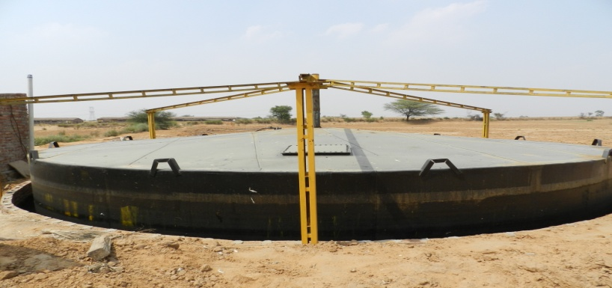
Bio Waste to Energy Flow Chart
Poultry Waste
Fruit & Vegetable Waste
Municipal Bio-Waste
Cow Dung
Electricity
Cooking Gas
Organic Manure

Slide 4
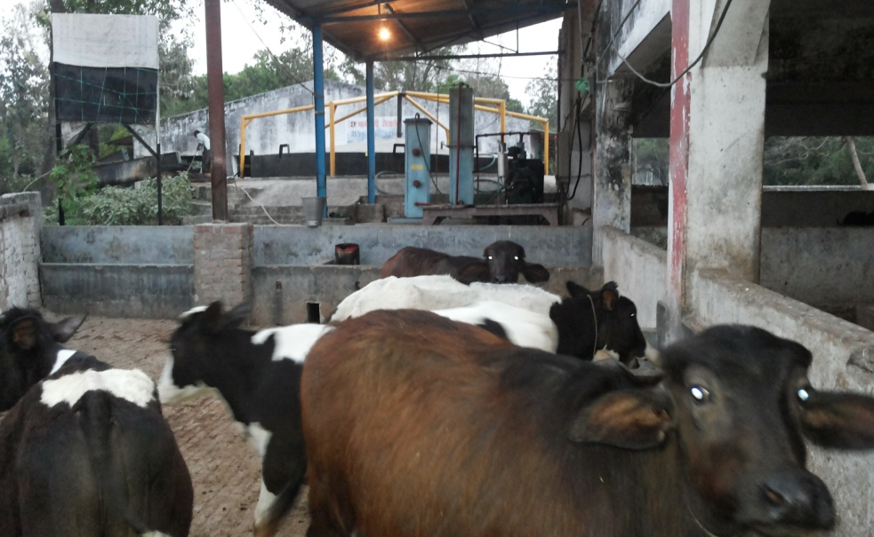
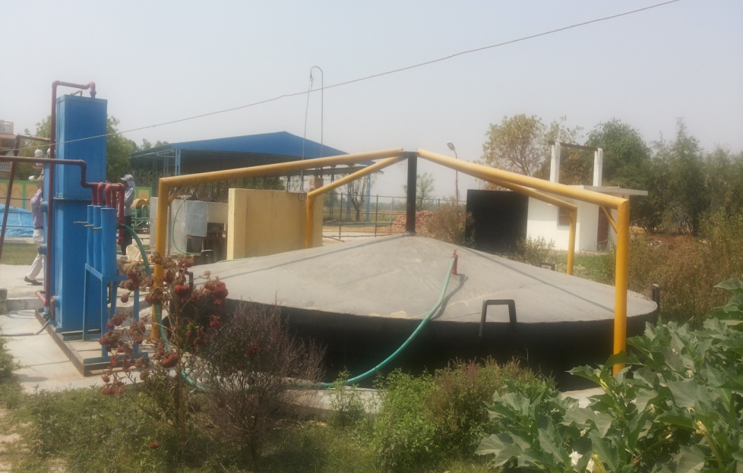
BIO-WASTE IS A PROVEN SUSTAINABLE POWER SOLUTIONS
More than 250 Bio Gas based Power Plants
Generating 60 Mega Watt of Power Per Day
Providing solutions to Industries , Villagers , Farmers, Institutions etc.

Slide 5
RURAL DEVELOPMENT DAIRY PROGRAM
OWNERSHIP : VILLAGERS SELF HELP GROUP
BENEFEIARIES : LOCAL VILLAGERS
OPERATED BY : PRIVATE BUSINESS PARTNER
SIZE OF DAIRY : 300 INDIAN BREED CATTLES
MEMBERS OF DAIRY : 300 FEMALES
REVENUE SHARING : PRIVATE OPERATOR &
300 BPL MEMBERS

Slide 6
PROJECT VIABILITY
PRODUCT 1 . COW MILK
TOTAL MILK PER DAY : 3600 LTRS.
MARKET SELLING PRICE PER LTR : Rs. 35 Per LTR.
COW FEED AND OTHER EXPENSES PER LTR : Rs. 15
PROFIT FROM 3600 LTRS OF PER DAY PRODUCTION : Rs. 72,000 Per Day
MONTHLY INCOME OF DAIRY : Rs. 21,60,000/-

Slide 7
PROJECT VIABILITY
PRODUCT 2. ELECTRICITY GENERATION FROM COW DUNG
TOTAL COW DUNG AVAILABLE PER DAY @ 12 kg per cow : 3600 KG
BIOGAS GENERATION PER DAY @ 15 kg per m³ : 240 m³ Per day
ELECTRICITY GENERATION @ 2 Kw Per m³ : : 480 Kw Per Day
20 Kw Bio Electricity Generation for 24 hrs
REVENUE BY SELLING 20 Kw ELECTRICITY TO HOUSEHOLD VILLAGERS @ Rs 3 Per Unit = Rs 10,800 per month
OTHER SAVINGS /BENEFITS :
8 hours of free electricity to run the dairy operations
10 hours of lighting to the village common streets from 7 pm to 5 am

Slide 8
PROJECT VIABILITY
PRODUCT 3. ORGANIC MANURE
SLURRY OUTPUT FROM BIOGAS DIGESTER PER DAY : 2880 Kg
ORGANIC MANURE AFTER VERMI COMPOST PROCESS PER DAY : 2304 Kg
MARKET SELLING PRICE PER Kg @ Rs 5 PER DAY : Rs 11520
EXPENSES PER Kg @ Rs 2 PER DAY : Rs 4608
NET REVENUE PER DAY : Rs 6912 ( PER MONTH = Rs 2,07,360)
OTHER SAVINGS /BENEFITS :
Healthy Organic Food
Saving of fertilizers and maintaining Land Fertility for long term

Slide 9
PROJECT VIABILITY
TOTAL REVENUE – RURAL DAIRY DEVELOPMENT PROGRAM
PRODUCT 1 : SELLING OF COWMILK : Rs 21,60,000
PRODUCT 2 : SELLING OF ELECTRICITY : Rs 10,800
PRODUCT 3 : ORGANIC MANURE : Rs 2,07,260
TOTAL REVENUE ( Per Month ) : Rs 23,78,060
SHARE OF BUSINESS PARTNER ( 30 %) : Rs 7,13,418
SHARE OF FARMERS (70%) : Rs 16,64,642
PROFIT SHARING PER MEMBER : Rs 5,549

Slide 10
COST OF SETTING UP ONE DAIRY
COST OF LAND (3 -5 ACRES non fertile land) : Rs. 40 Lac
CONSTRUCTION EQUIPMENTS : Rs 180 Lac
BIOGAS POWER GENERATION PLANT : Rs 40 Lac
DAIRY OPERATING / RESERVE FUND : Rs 20 Lac
COST OF 300 CATTLES @ 40,000 PER CATTLE : Rs 120 Lac
TOTAL COST : Rs 400 Lac ( 4 Cr.)
RETRUN ON INVESTMENT = 17 MONTHS

Slide 11
BENEFITS
1. Livelihood Generation.
2. Improving breed of Indian cows and promoting the same as the milk is more healthier and disease free in comparison to ‘HF’ and ‘Jersey’
3. Saving cows from going to the slaughter houses.
4. Production of Organic Manure and Easy availability of low cost manure.
5. Decentralized Power Generation for Lighting of Village households.
6. Employment Creation At Village Level.
7. Savings on Chemical fertilizer / Subsidy – Benefit going to fertilizer Co.
8. Healthy Vegetable and crop production .
9. Sustainable Socio-Economic Development in Rural Areas.

Slide 12
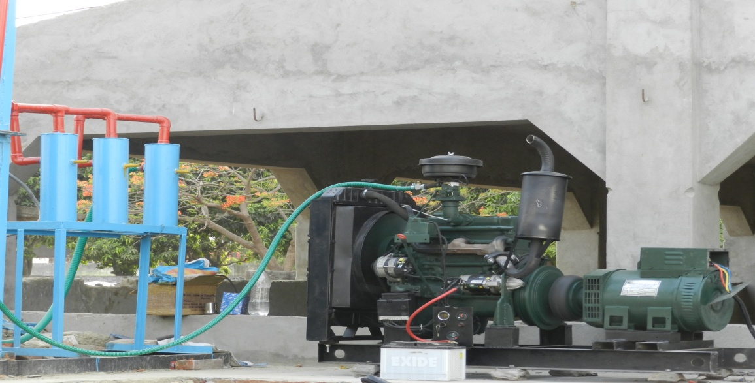
BENEFITS Contd……
10. Growth in Milk Production
11. Increase in Commercial Activities in Rural Areas
12.Providing and promoting ‘Ox’ for cultivation of farmland as the same would save them going to slaughter houses and save the diesel used for running tractors.
13. Electrification of Village.

Slide 13
Electricity Generation Power Projects undertaken on different Bio-Wastes
Cow Dung
Dairy Farmers, Gowshalas (cow shelters), Village Panchayats, Milk Cooperatives, Veteran Hospitals, Municipal Corporation Cattle Shelters, Agriculture Universities and Dairy Institutions
Poultry Waste
Poultry Farmers: Layer Farms, Hatchery Farms & Broiler Farms
Vegetable, Fruit & Kitchen Waste
Vegetable Markets, Agro and Food based companies, Hostels, Hotels, Restaurants, Canteens, Hospitals, Housing societies, Institutions, Waste dumping fields etc.
Algae
Fish Pond owners, Municipal Corporation, Government Agencies, Fish hatcheries
Rice Husk (Producer Gas)
Rice Mills, Village Panchayats, Village Farmers, Industries etc.
Wood Briquette ( Producer Gas)
Furniture Manufacturers, Paper Mills, Other Wood based Industries

Slide 14

A Small change in mind set can make a Big Difference……
THANKS

